Slide 1
User Input
(Text + Language)
React Frontend
(Web / Mobile)
FastAPI Backend
Translation Engine
(Indian Languages)
Speech Synthesis
(TTS)
Audio Encoding
(Base64)
Translated Text + Audio Output

Slide 2
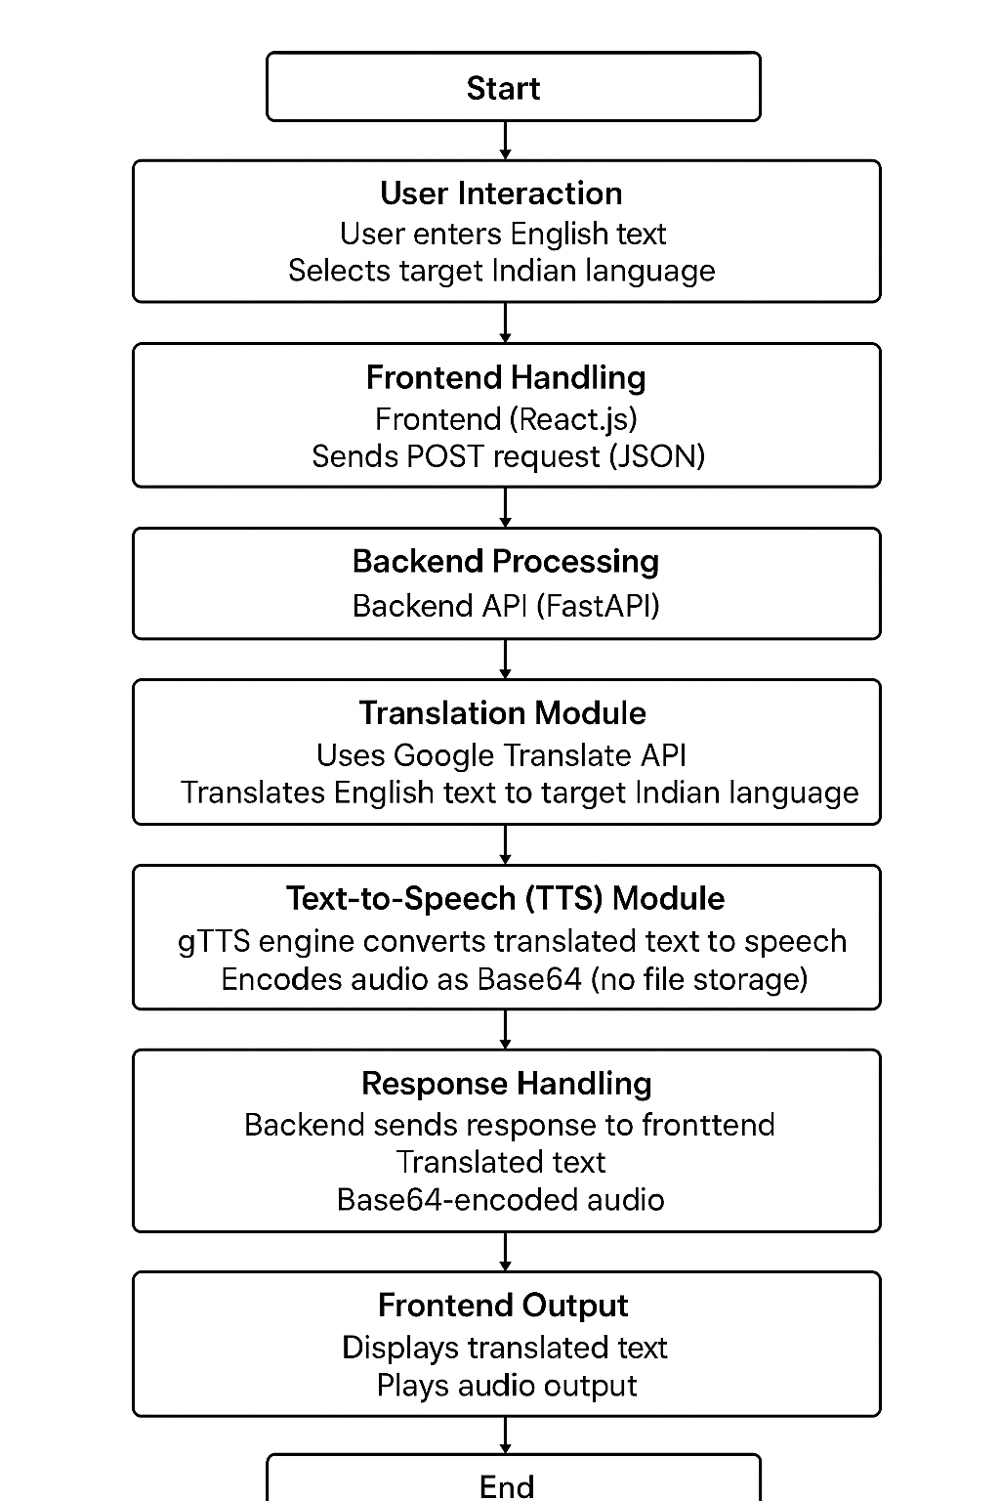

Slide 3
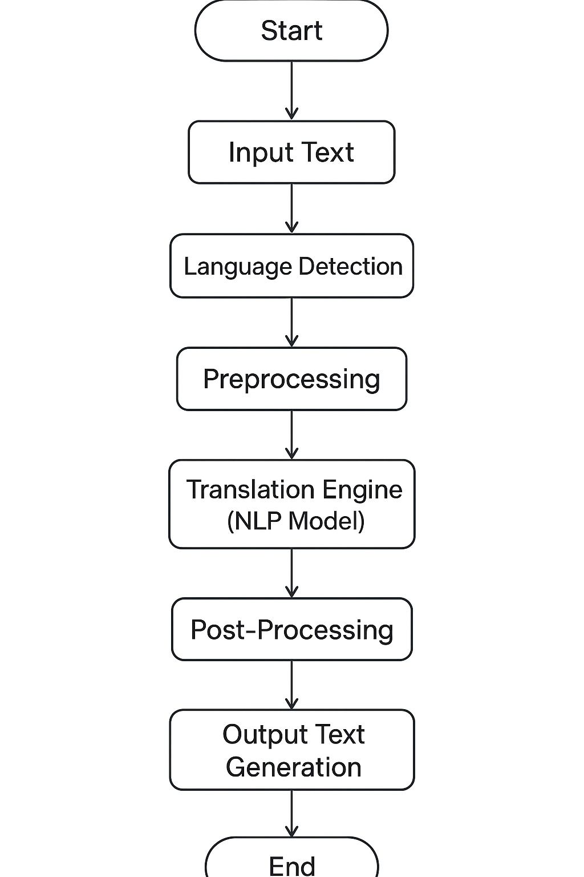

Slide 4
